Slide 1
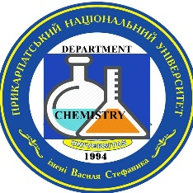
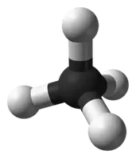
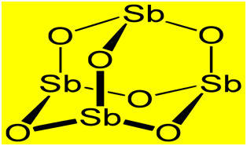
Ministry of Education and Science of Ukraine Vasyl Stefanyk Prykarpattia National University, Faculty of Natural Sciences, Department of Chemistry
INVESTIGATION OF COMPOSITION AND NANOSTRUCTURAL PROPERTIES OF INDUSTRIAL COMMERCIAL ANTI-PYRENES Sb2O3
Sergiy Kurta1, Anna Rega1, Lilya Yaremchuk 2, Anastasia Alieva 1
1-Precarpathian National Vasyl Stefanyk University,57 Shevchenko St.,Ivano-Frankivsk 76018 Ukraine sergiykurta@pnu.edu.ua,
2. TARKETT VINISIN, TOV 77300, Ivano-Frankivska obl., m. Kalush, vul. Promyslova, 10
1

Slide 2
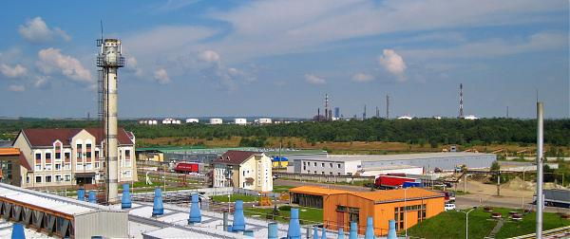
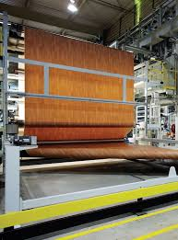
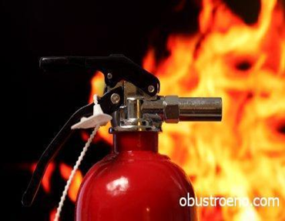
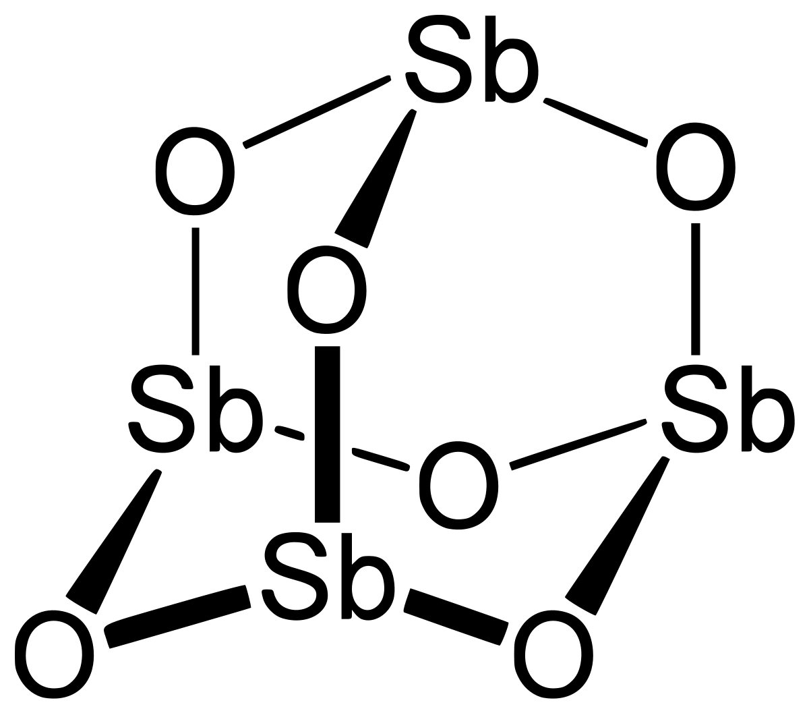
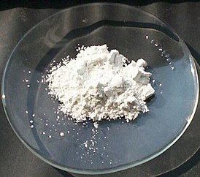
Sergiy Kurta, Anna Rega, Lilya Yaremchuk, Anastasia Alieva.
INVESTIGATION OF COMPOSITION AND NANOSTRUCTURAL PROPERTIES OF INDUSTRIAL COMMERCIAL ANTI-PYRENES Sb2O3
Year by year, the number of fires is increasing not only in Ukraine, but also in the world. Numerous human casualties and significant material losses once again emphasize the importance of flame retardants — special additives to various materials, incl. PVC linoleum, reducing its flammability.
In the city of Kalush, in the Ivano-Frankivsk region, there is the largest production of linoleum in Ukraine, the productivity of which is 10 million square meters. m per year. The plant operates 1 combined line for the production of heterogeneous household and commercial linoleum. Since April 2011, the plant has started the production of sports PVC coatings, aimed at meeting the needs of the Eastern European market. Often, the company uses raw materials and materials, according to a commercial secret, of unknown composition, including complex complex FIRE RETARDANTS based on antimony trioxide Sb2O3.
2

Slide 3
Sergiy Kurta, Anna Rega, Lilya Yaremchuk, Anastasia Alieva.
INVESTIGATION OF COMPOSITION AND NANOSTRUCTURAL PROPERTIES OF INDUSTRIAL COMMERCIAL ANTI-PYRENES Sb2O3
Table 1. Characteristics of industrial flame retardants of TARKETT VINISIN LLC.
Аналітичні характеристики зразків антипіренів Sb2O3 № №1.2.3.,4
№ | Назва показників | 1-Sb2O3 | 2--Sb2O3 | 3-Sb2O3 | 4-Sb2O3
1 | рН 4% вод. диспер. | 7,9 | 7,8 | 8,1 | 7,9
2 | Насипна вага, г/л | 75 | 72 | 81 | 76
3 | Вміст Н2О,при 105^{о}С, 2год. % | 0,39 | 0,39 | 0,49 | 0,43
4 | Втрати прок. При 900^{о}С% | 11,54 | 0,001 | 16,8 | 13,5
5 | Питома поверхня, S м2/г | 0,51 | 1,45 | 1,56 | 0,58
In our work, with the help of IR-spectroscopy, DTA-analysis, and diffractometric and X-ray luminescence analysis, we conducted our research on the composition and fire-resistant properties of industrial complex flame retardants for PVC linoleum manufactured by TARKETT VINISIN, Kalush, Ukraine, of unknown composition based on Sb2O3, and proposed a new the mechanism of their complex flame retardant and stabilizing effect is based on the composition of industrial flame retardants determined by us, which additionally includes CaСО3 identified by us.
First, the physicochemical characteristics of 4 different samples of antimony trioxide Sb2O3 #1.2.3,4 were analyzed and studied. All these samples of flame retardants were provided by TARKETT VINISIN LLC, Kalush, Ivano-Frankivsk Region, Ukraine [6]. The characteristics of which are presented below in tab 1.
3

Slide 4
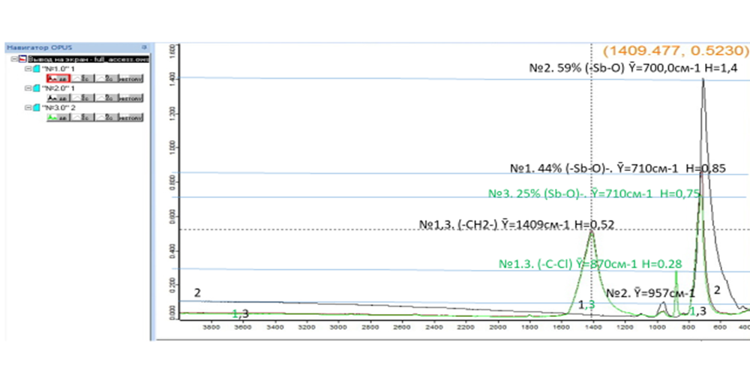
Sergiy Kurta, Anna Rega, Lilya Yaremchuk, Anastasia Alieva.
INVESTIGATION OF COMPOSITION AND NANOSTRUCTURAL PROPERTIES OF INDUSTRIAL COMMERCIAL ANTI-PYRENES Sb2O3
Fig. 1. IR spectrum of samples #1.2.3. of flame retardant Sb2O3 on the ALPHA I Fourier transform spectrometer.
To determine the qualitative composition of 4 different samples of Sb2O3 flame retardants, a qualitative and quantitative analysis of the chemical composition of the samples was carried out on a special device "IR-Fourier spectrometer ALPHA II". The IR spectra of 3 Sb2O3 samples were obtained and described, the results of which are presented in the IR spectrogram of fig. 1. The basis for all samples is antimony trioxide Sb2O3 [7], but with different content of the main substance: At the same time, sample No. 1 contains 56% of impurities of other substances, and sample No. 3 contains up to 75% of other substances, quantitative and the qualitative composition of which will be determined by other methods and described later in our work.
4

Slide 5
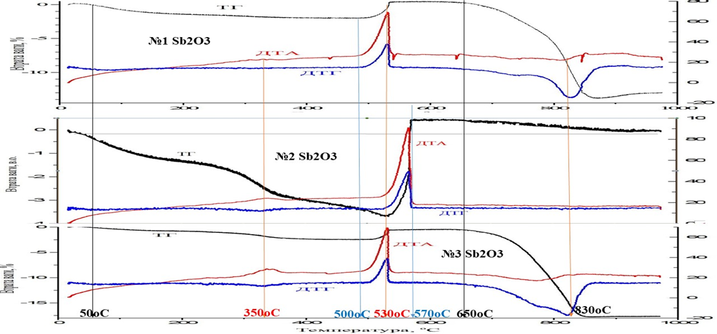
Sergiy Kurta, Anna Rega, Lilya Yaremchuk, Anastasia Alieva.
INVESTIGATION OF COMPOSITION AND NANOSTRUCTURAL PROPERTIES OF INDUSTRIAL COMMERCIAL ANTI-PYRENES Sb2O3
Fig. 2. Comparative DTA - red curve, DTG - blue curve, and TG - black curve, dependences of mass change of Sb2O3 samples No. 1-, No. 2-, No. 3, the characteristics of which are presented in tab. 2.
To determine the qualitative composition of 3 different samples of Sb2O3 flame retardants, a quantitative DTA - differential thermal analysis of the thermal chemical stability of the samples was carried out on a special DTA-analyzer device at the Institute of Chemical Engineering of the National Academy of Sciences of Ukraine. DTA, DTG (differential thermal gravimetry) and TG (thermogravimetric) curves of 3 Sb2O3 samples were obtained and described, the results are presented in Fig. 2.
5

Slide 6
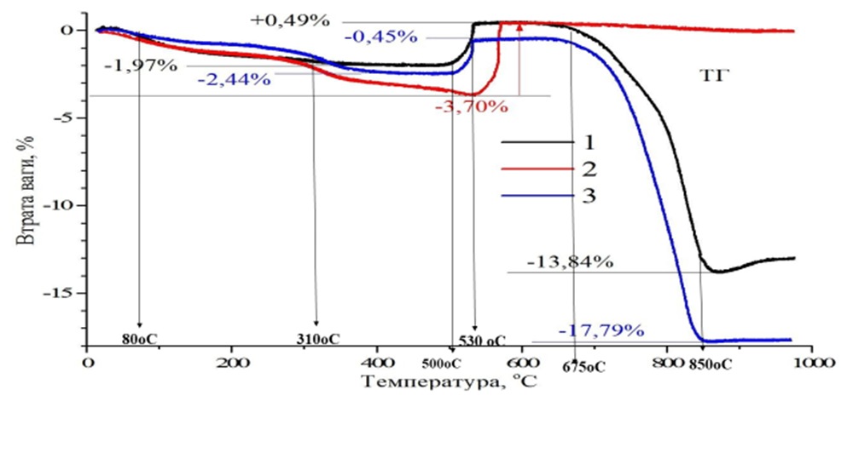
Sergiy Kurta, Anna Rega, Lilya Yaremchuk, Anastasia Alieva.
INVESTIGATION OF COMPOSITION AND NANOSTRUCTURAL PROPERTIES OF INDUSTRIAL COMMERCIAL ANTI-PYRENES Sb2O3
Fig. 3. Comparative TG curves during DTA analysis of the dependence of the mass change of flame retardant samples: Sb2O3 #1-black curve, #2-red curve, #3-blue curve. (Sb2O3+O2= Sb2O5( MM290+32=MM322 Ϫ=9, 9%
Analyzing the data presented in Figures No. 2 and No. 3, the following can be said: 1) The thermal decomposition of all samples of Sb2O3 flame retardants with loss of volatile substances and moisture begins at 50-80°C (Fig. 2, Fig. 3), while these losses at 500- 530oC can reach 1.97% (black TG curve) for sample #1, 2.44%-(blue TG curve) for sample #3, and the most 3.7% for sample #2 (red curve). 2) Upon reaching this temperature of 500-530oC, there is an abnormal increase-restoration of weight for all samples of Sb2O3 flame retardants by almost the same values ​​minus 0.45-0.49% for samples No. 1.3. While for sample Sb2O3 No. 2, the weight gain is completely restored by 3.7% fig. 3. It is possible that the following reaction of transformation of antimony trioxide into antimony pentoxide Sb2O5 takes place, and the mass of the samples increases, reaction No.
1. : Sb2O3+O2→500oС→ Sb2O5 #1. MM290+32=MM322
6

Slide 7
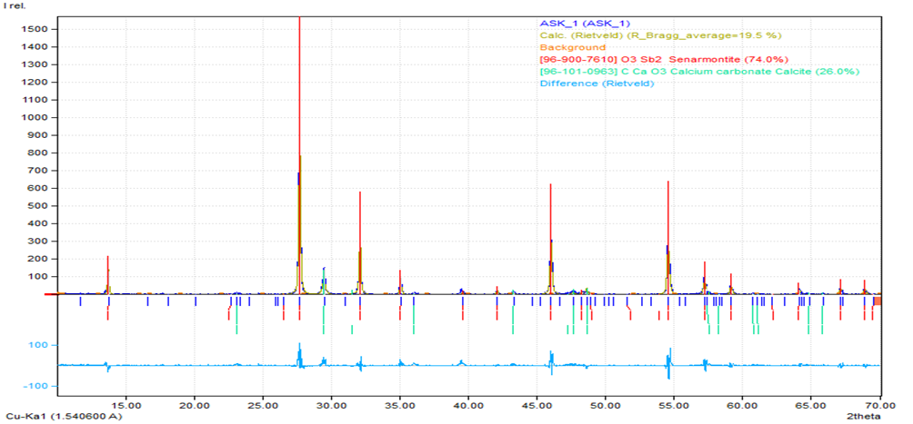
Sergiy Kurta, Anna Rega, Lilya Yaremchuk, Anastasia Alieva.
INVESTIGATION OF COMPOSITION AND NANOSTRUCTURAL PROPERTIES OF INDUSTRIAL COMMERCIAL ANTI-PYRENES Sb2O3
Fig. 4. Diffractogram of sample #1 Sb2O3, composition 74% Sb2O3 + 26% CaCO3. The phase composition of the samples was determined using a Shimadzu XRD-7000 diffractometer (θ −2θ scheme) equipped with a Cu-Kα radiation tube (λ = 1.5418 Å) operating at 30 kV and 40 mA. Full refinement of the Rietveld pattern was performed using FullProf software.
For a more accurate qualitative and quantitative analysis and determination of the composition of 3+1=4 x samples of Sb2O3 flame retardants, the phase composition of the samples was performed using a Shimadzu XRD-7000 diffractometer
7

Slide 8
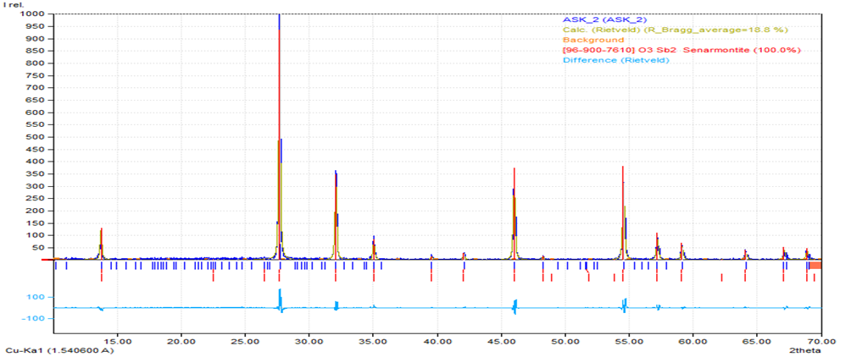
Sergiy Kurta, Anna Rega, Lilya Yaremchuk, Anastasia Alieva.
INVESTIGATION OF COMPOSITION AND NANOSTRUCTURAL PROPERTIES OF INDUSTRIAL COMMERCIAL ANTI-PYRENES Sb2O3
Fig. 5. Diffraction pattern of sample №2 Sb2O3, composition 100% Sb2O3.
In fig. 5 shows the qualitative and quantitative composition, according to the diffractogram of sample #2 Sb2O3, which consists of 100% Sb2O3, on a Shimadzu XRD-7000 diffractometer
8

Slide 9
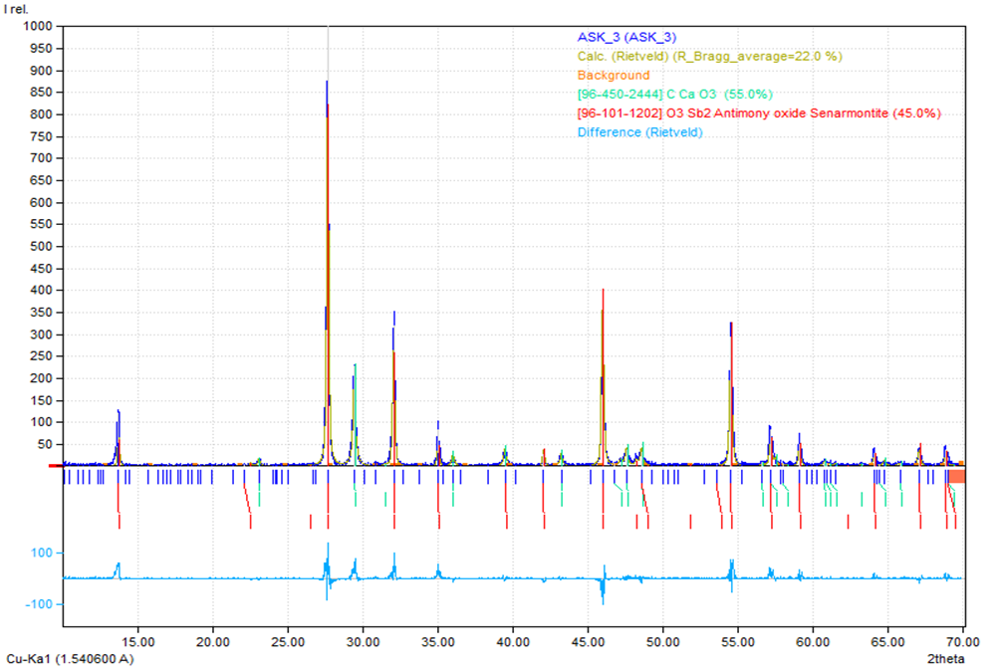
Sergiy Kurta, Anna Rega, Lilya Yaremchuk, Anastasia Alieva.
INVESTIGATION OF COMPOSITION AND NANOSTRUCTURAL PROPERTIES OF INDUSTRIAL COMMERCIAL ANTI-PYRENES Sb2O3
Fig. 6. Diffraction pattern of sample No. 3 Sb2O3, composition 45% Sb2O3 + 55% CaCO3.
In fig. 6 shows the qualitative and quantitative composition, according to the diffractogram of sample #3 Sb2O3, which consists of 45% Sb2O3 + 55% СaCO3. , on a Shimadzu XRD-7000 diffractometer.
9

Slide 10
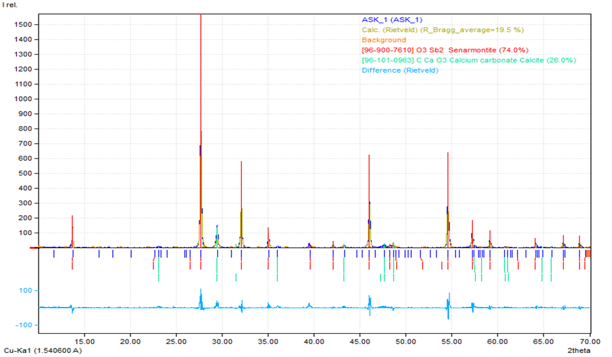
Sergiy Kurta, Anna Rega, Lilya Yaremchuk, Anastasia Alieva.
INVESTIGATION OF COMPOSITION AND NANOSTRUCTURAL PROPERTIES OF INDUSTRIAL COMMERCIAL ANTI-PYRENES Sb2O3
Fig. 7. Diffraction pattern of sample #4 Sb2O3, composition 72% Sb2O3 + 28% CaCO3
In fig. 7 shows the qualitative and quantitative composition, according to the diffractogram of sample #4 Sb2O3, which consists of 72% Sb2O3 +28% СaCO3, on a Shimadzu XRD-7000 diffractometer
10

Slide 11
Sergiy Kurta, Anna Rega, Lilya Yaremchuk, Anastasia Alieva.
INVESTIGATION OF COMPOSITION AND NANOSTRUCTURAL PROPERTIES OF INDUSTRIAL COMMERCIAL ANTI-PYRENES Sb2O3
Tab. 2. Phase composition of inorganic substances in flame retardant samples No. 1, 2, 3, 4 based on X-ray fluorescence spectroscopy analysis.
Thus, analyzing the data of diffractograms shown in Fig. 4.5.6.7, the following conclusions can be drawn. Samples 1, 3, 4, (Fig. 4-7) consist of two phases, two inorganic components, namely antimony trioxide antimony - Sb2O3 and an additional component of microcrystalline calcium carbonate - CaСО3 with impurities of organic substances, in appropriate quantities [10], and sample No. 2 is filled with pure antimony trioxide (100%), the characteristics of which are indicated in Table 2.
11

Slide 12
Sergiy Kurta, Anna Rega, Lilya Yaremchuk, Anastasia Alieva.
INVESTIGATION OF COMPOSITION AND NANOSTRUCTURAL PROPERTIES OF INDUSTRIAL COMMERCIAL ANTI-PYRENES Sb2O3
The mechanism of the reaction of thermostabilizing and flame retardant action of Sb2O3 + CaCO3.
Based on the obtained experimental data, we can predict the mechanism of heat-stabilizing and fire-retardant action of the above samples of flame retardants based on antimony oxide and in PVC according to the corresponding reactions""1-6:
Calcium carbonate can interact with hydrogen chloride during the thermal decomposition and burning of PVC, according to the following reactions No. 1-6: 1. PVC(-СН2-СНСl-)n →140oC→(-CH=CH-)n+ nHCl↑
2. СаСО3 + 2HCl →140-500oC→ CaCl2 + Н2О + СО2
Upon further heating and burning of the PVC material, antimony trioxide and pentaoxide enters the chemisorption reaction, with the formation of the corresponding antimony chlorides, as volatile compounds are removed, evaporate from the reaction zone already at 260-300oC: 3. Sb2O3+6HCl→500oC→2SbCl3↑ +
4. Н2ОSb2O5+10HCl→500oC→2SbCl5↑+ 5Н2О
Upon further heating and burning of PVC material above 675°C, according to the DTA analysis described in the annotated report No. 2, calcium carbonate begins to decompose, with the release of calcium oxide and carbon dioxide, which suppresses combustion, as it isolates the material from oxygen in the air.
5 . СаСО3→675-825оС → СаО + СО2↑
In addition, calcium chloride can be formed from calcium oxide and hydrogen chloride:
6. СаО + 2НСl→825оС→CaCl2 + H2O
12

Slide 13
Sergiy Kurta, Anna Rega, Lilya Yaremchuk, Anastasia Alieva.
INVESTIGATION OF COMPOSITION AND NANOSTRUCTURAL PROPERTIES OF INDUSTRIAL COMMERCIAL ANTI-PYRENES Sb2O3
Conclusions
In the work, experimental studies were carried out and qualitative IR spectral analysis and quantitative calculation of IR curves based on the results of the study of 4 samples of flame retardants based on Sb2O3 were performed. Based on the analysis of the IR spectrum, organic substances were identified in the Sb2O3 samples with the frequency of deformation oscillations (C-H) of the bonds of the hydrocarbon chain in the region of 1409 cm-1 of hydrocarbons. Another sample of Sb2O3 No. 3 contains a frequency of 870 cm-1 valence absorption of the bond (С-Сl) with an intensity of Н=0.28 in organochlorine compounds, which can be used as synergists together with Sb2O3
Thermal decomposition of all samples, DTA analysis of flame retardants Sb2O3 begins to lose volatile substances and moisture at 50-80°C, while these losses at 500-530°C can reach 1.97% - 3.7% for 4 samples. The Sb2O3 flame retardant sample No. 2 begins to work as a flame retardant at a higher temperature of 530-570°C and subsequently does not lose its characteristics when heated up to 1000°C. Thus, it can be assumed that the sample of flame retardant #1 has the main amount of substance Sb2O3 #1 85-87%. Sb2O3 and additionally contains 15-13% of an unknown impurity.
Samples of flame retardants, based on X-ray fluorescence spectroscopy, on a diffractometer and ShimadzuXRD-7000, consist of two phases, two inorganic components, namely antimony trioxide - Sb2O3 and an additional component of microcrystalline calcium carbonate - CaСО3 with impurities of organic substances, in appropriate quantities 13-15%.
4. An improved chemistry and reaction mechanism of stabilization and flame retardant action of complex flame retardant for PVC-linoleum compositions was proposed, in a large temperature range from 80°C to 1000°C
11

Slide 14
Sergiy Kurta, Anna Rega, Lilya Yaremchuk, Anastasia Alieva.
INVESTIGATION OF COMPOSITION AND NANOSTRUCTURAL PROPERTIES OF INDUSTRIAL COMMERCIAL ANTI-PYRENES Sb2O3
Literature
1.Fadeev S.S. and co-authors. Interaction of antimony oxide with chlorine-containing organic compounds in polyolefin compositions. Magazine of the Navy, volume АХХV11, 1985, No. 3, c.543-549.
2.Kaidarova R.V., Artemova T.A., Surnyn E.G., Ponomareva E.A., Vorob'eva I.M., Tarasov V.A., Kurta S.A. Influence of modification of silica on the flammability, thermal stability and smoke formation of polyvinyl chloride. Aviation materials, 1988, Moscow, p. 89-92.
3.The synthesis and properties of filled polyvinyl chloride. Author(s): Kurta, S.A., Chuiko, A.A., Khaber, N.V., Novokshonova, L.A. Publication year: 1985. Journal / Book title: Polymer Science U.S.S.R.р.23-25.
4.Kurta S.A., Kurganskyi V.S. "Analysis of PVC by chromatography and DTA". Collection of abstracts of reports of the 3rd international symposium on the analysis of polymers and their characteristics, Czechoslovakia, Brno, July 22-27, 1990, Art. R-B-50.
5. Fire retardants. https://vitahim.ru/catalog/syre_dlya_pererabotki_pvkh/antipireny/.2008
6. Fadeev S.S. and other authors. Study of the interaction of antimony oxide with a chlorine-containing organic compound in polyolefin compositions.// Navy, 1985, vol. 27, No. 3, p. 543-549. (in Russian).
7. Combustion of polymers and materials reducing their combustibility. October 16, 2021/ LLC "POLIKONTA-P", Republic of Belarus, Minsk, https://www.polikonta.com/index.php?mod=look_items_more&id_item=175&id_cat_prec=36&cat_part=1
8. Nikolaes V.G. and other authors.. Electrical insulating composition, Patent RU No. 2272330. Pub. 07/05/2004 (in Russian).
9. T.A. Borukaev and other authors. Influence of molybdenum compound on fire resistance and physical and mechanical properties of PVC compound.// Plastics. No. 11-12. 2017, p.35-39. (in Russian).
10. Flame retardants for PVC. US patent. No. 4098748. С08К3/20..1978.
11

Slide 15
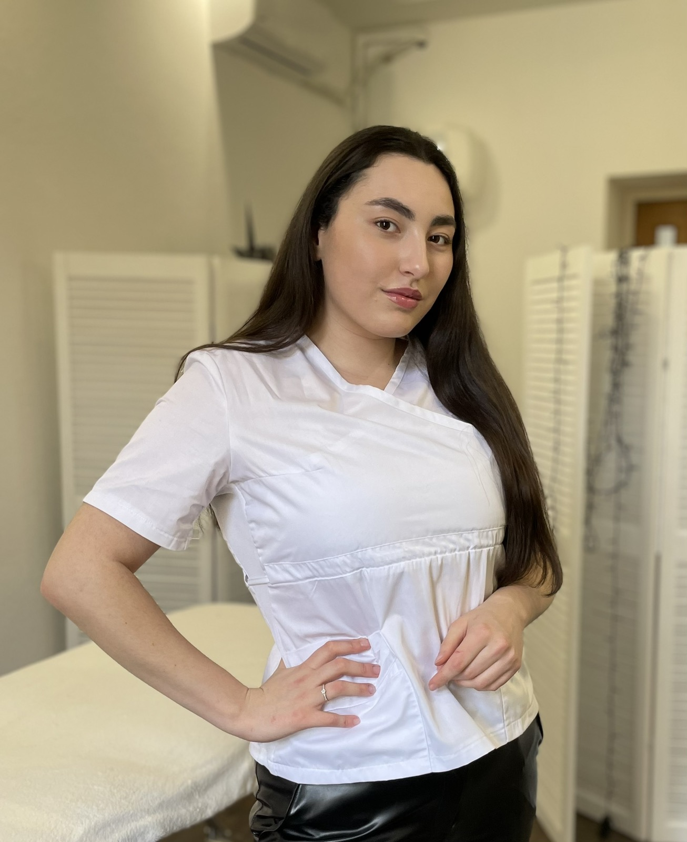
Sergiy Kurta, Anna Rega, Lilya Yaremchuk, Anastasia Alieva.
INVESTIGATION OF COMPOSITION AND NANOSTRUCTURAL PROPERTIES OF INDUSTRIAL COMMERCIAL ANTI-PYRENES Sb2O3
Authors:
1. Sergiy Kurta
Academician of the Academy of Sciences of Ukraine, Doctor of Technical Sciences, Professor of the Department of Chemistry of the Prykarpattia National University named after Vasyl Stefanyk in Ivano-Frankivsk, Ukraine. Honored rationalizer and inventor of Ukraine, author of more than 250 publications and scientific and technical journals, including 50 publications in international publications of other countries, including 42 inventions and patents.
3. Anna Rega
Student of the 4th year, group X-41s. (bachelor) of the Department of Chemistry, Faculty of the Carpathian National University. Vasyl Stefanyk in Ivano-Frankivsk, Ukraine.
3. Liliya Yaremchuk
Director of development and quality, head of the laboratory of TARKETT VINISIN LLP in Kalush, Ivano-Frankivsk region, Ukraine
Ліля Яремчук
4. Anastasia Aliyeva
Student of the 4th year, group X-41z. (bachelor) of the Department of Chemistry, Faculty of the Carpathian National University. Vasyl Stefanyk in Ivano-Frankivsk, Ukraine.
11

